Slide 1
Lab excercise 1 Using an ARM system
Julio César Almada Fuerte
A00226046
ITE

Slide 2
Part 1
Learn how to use the Intel FPGA monitor program.

Slide 3
Install Intel FPGA Monitor Program
https://www.intel.com/content/www/us/en/programmable/support/training/university/materials-software.html
Choose Monitor program
Download the latest version

Slide 4
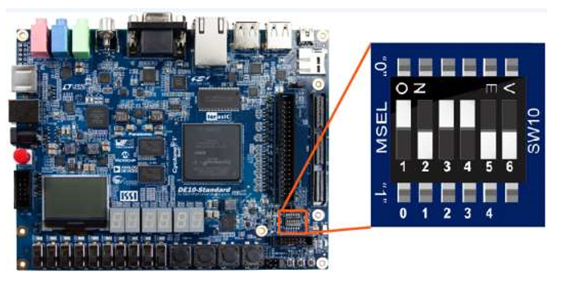
Configure the Mode Select from your device
Connect you device with the host computer through the USB-Blaster and turn it on.

Slide 5
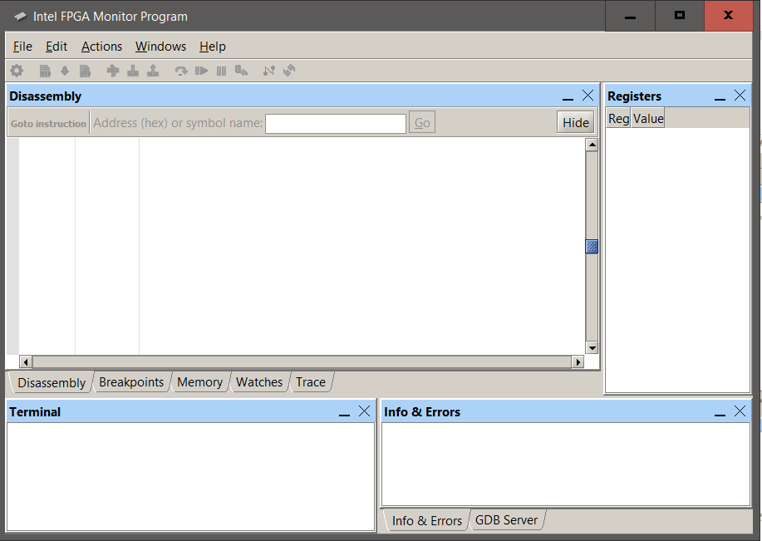
Open Intel FPGA Monitor Program

Slide 6
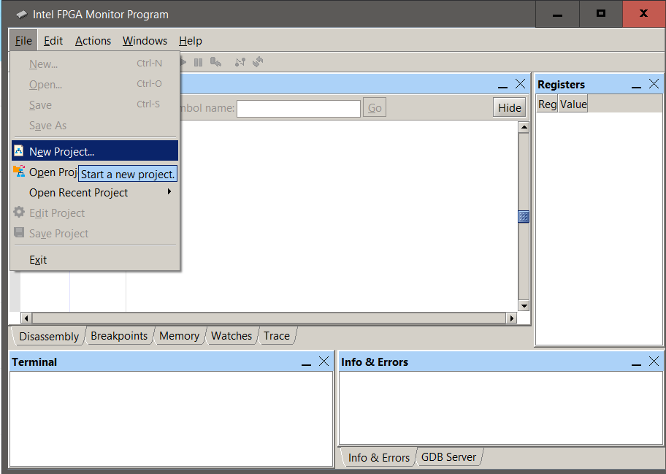
Create a new project

Slide 7
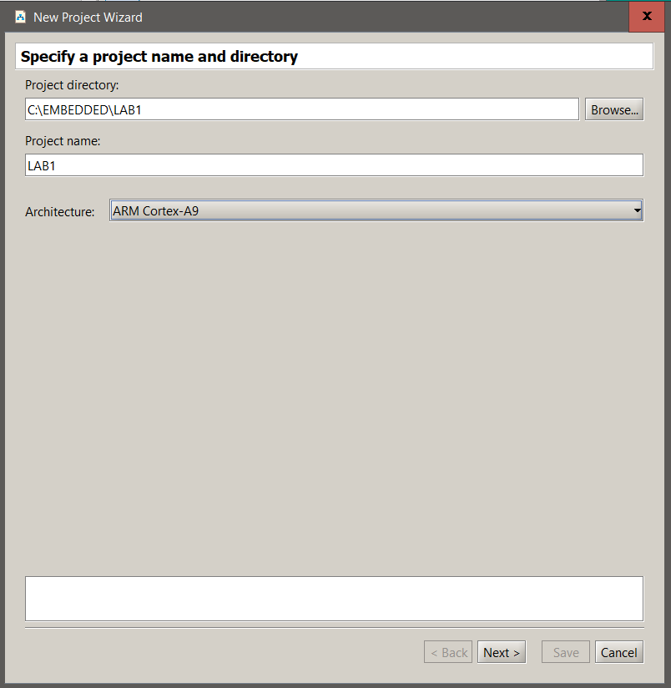
1)
Select a Project
directory (Avoid large paths).
Provide a Project name
For processor architecture choose
ARM Cortex A-9

Slide 8
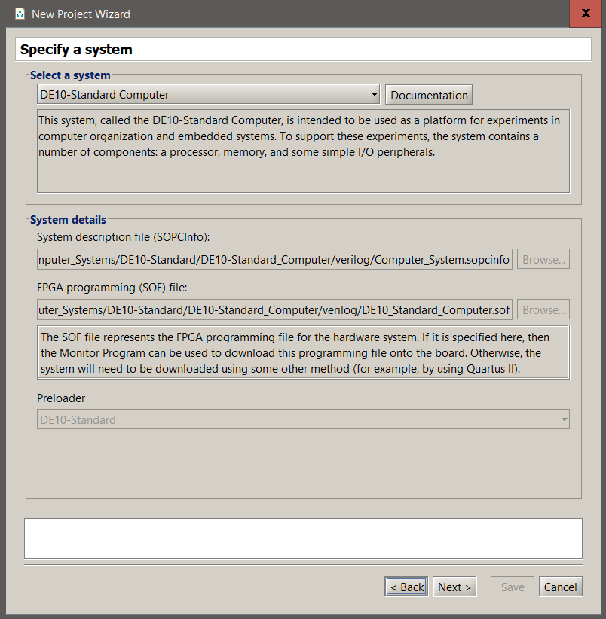
2)
On the select a system choose the
device you are utilizing.

Slide 9
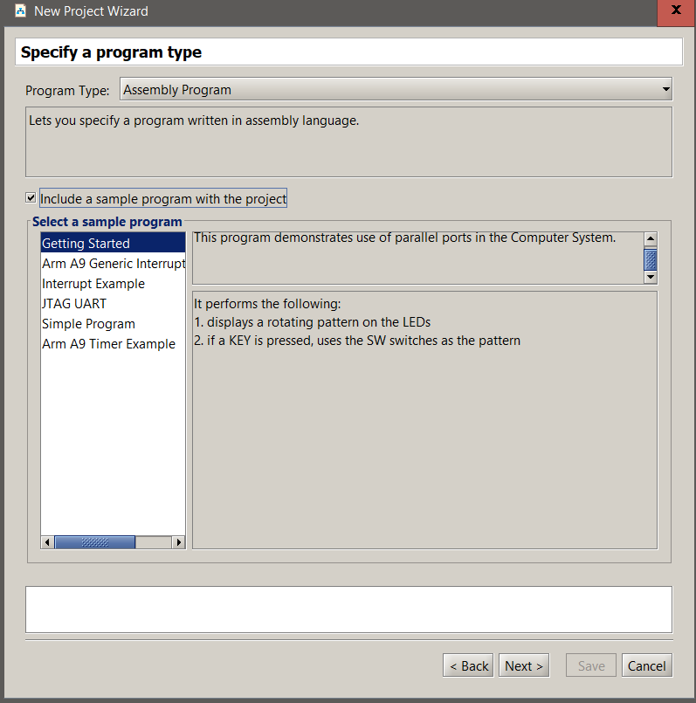
3)
Program type:
Assembly program
Check on the Include a sample
Pick “Getting Started”
sample program

Slide 10
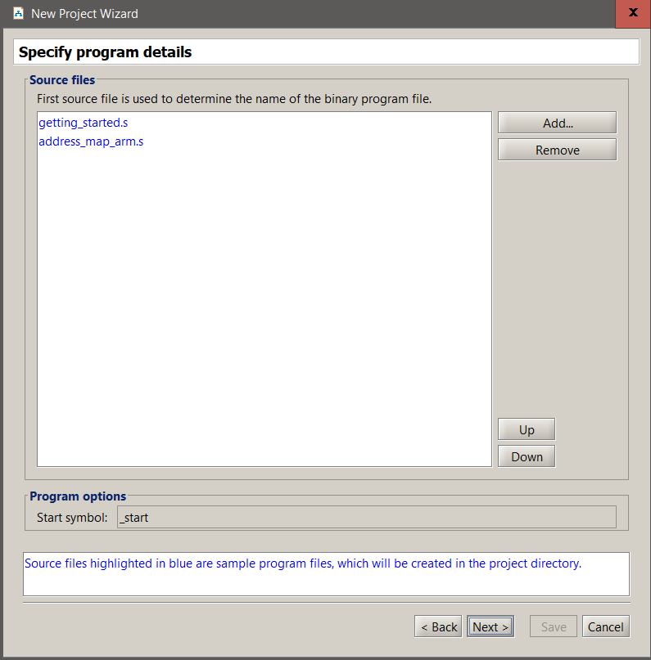
4)
Code will be generated by the
monitor program.
Click next

Slide 11
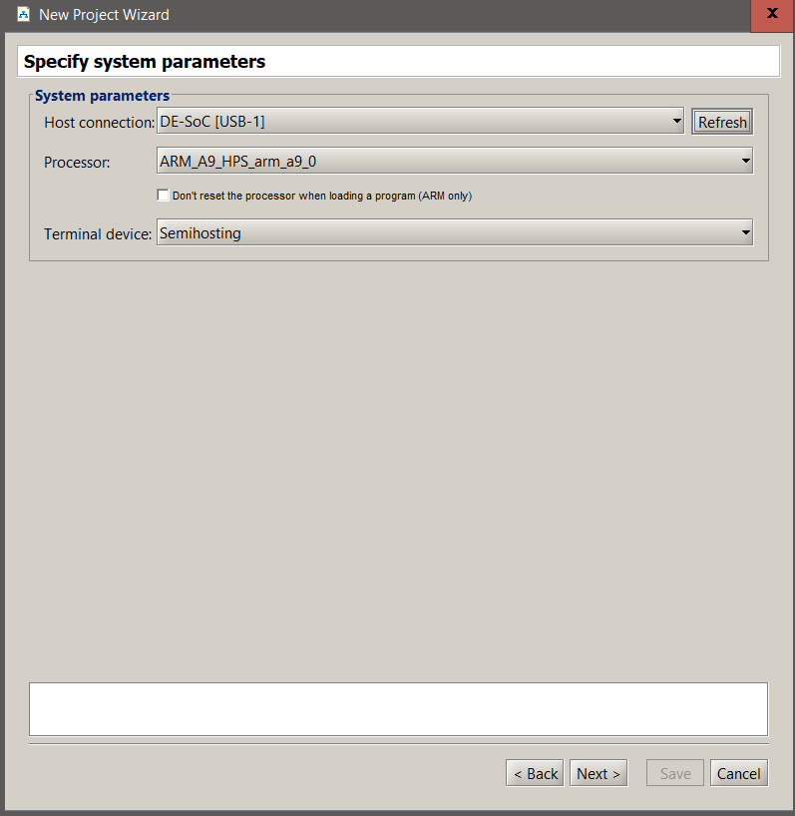
5)
Make sure the host
connection specifies the USB
connector from your device.

Slide 12
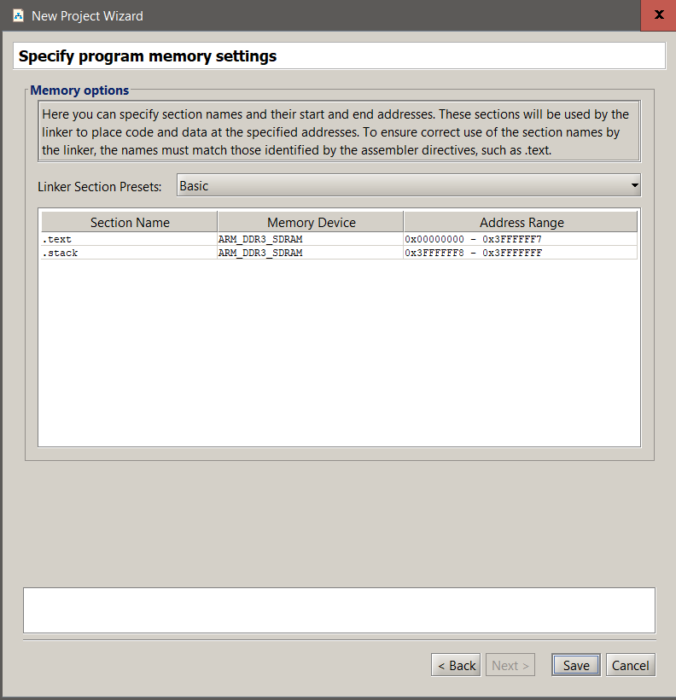
6)
You do not have to alter
anything from this window,
just click on next.

Slide 13
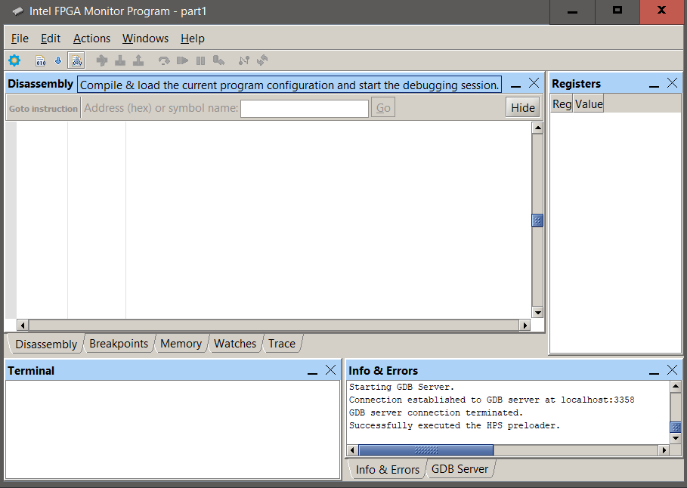
7)
Click on Compile and
load program, so that
you can execute the
code in your device.

Slide 14
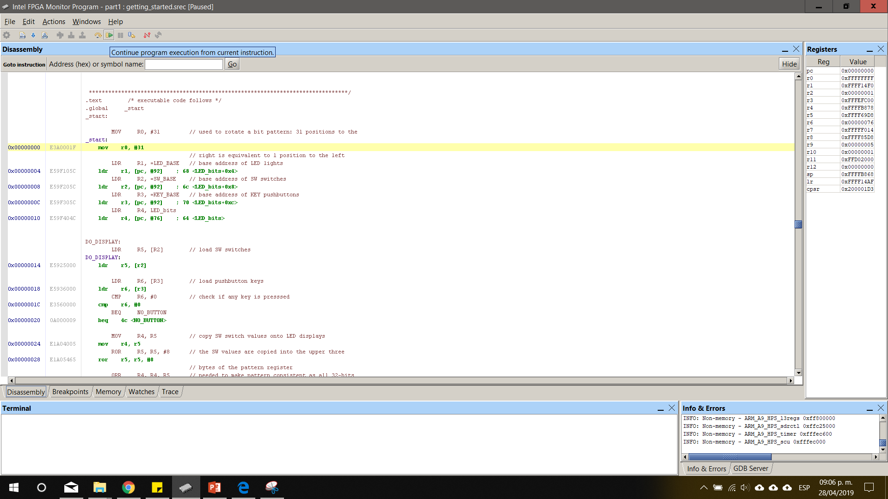
8)
Make a click on
Continue program
execution from
current
instruction.

Slide 15
Part 2
Gives the largest number from a list.
Create a new folder.
Inside that folder create a file called PART2.s
Follow the steps from the previous part until you reach the “Specify a program type”.

Slide 16
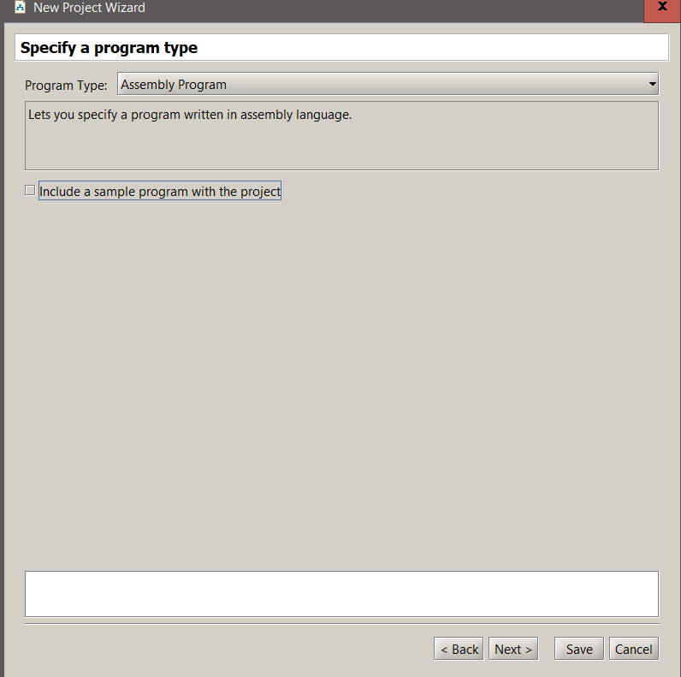
Instead of clicking on the
include a sample box, just
click on next.

Slide 17
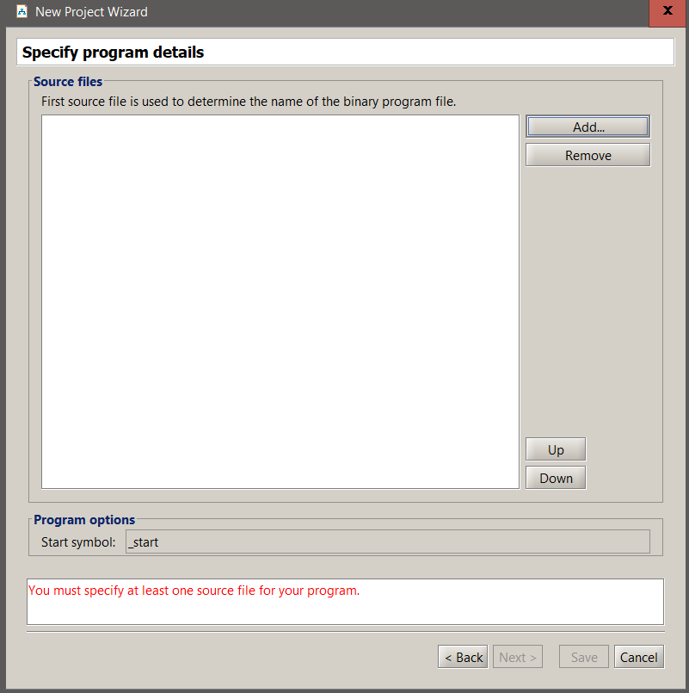
In this window make a click
on the add button.

Slide 18
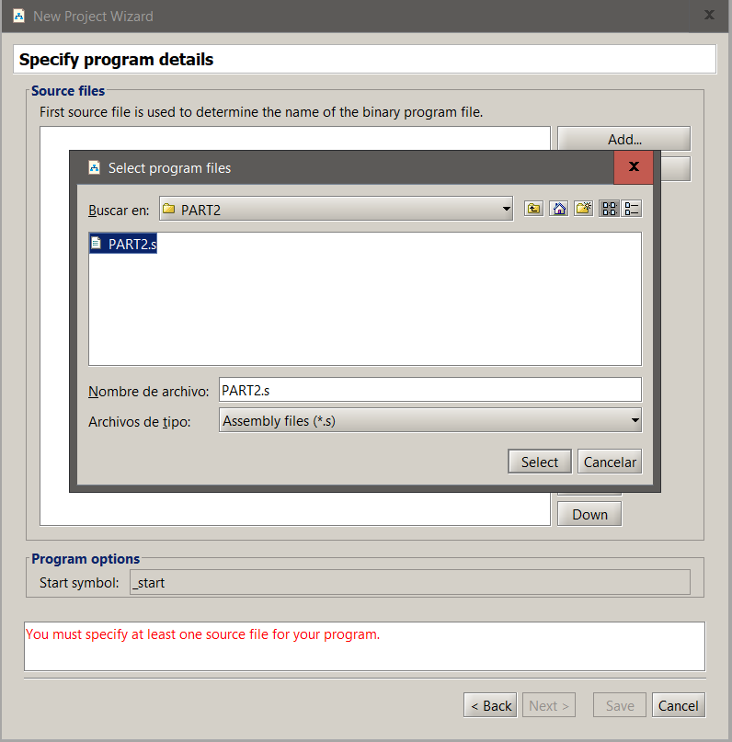
Select the PART2.s file
you created previously.

Slide 19
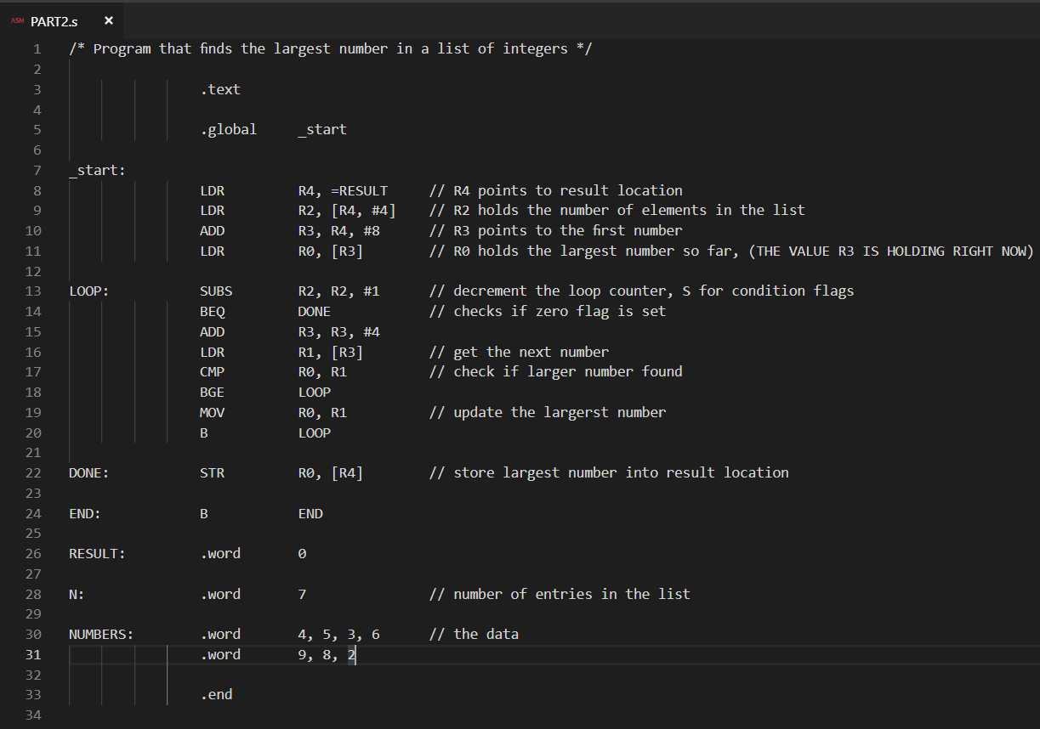
Edit the PART2.s file
and add this code.

Slide 20
PART 3
Does the same as the part 2 but making use of a subroutine.

Slide 21
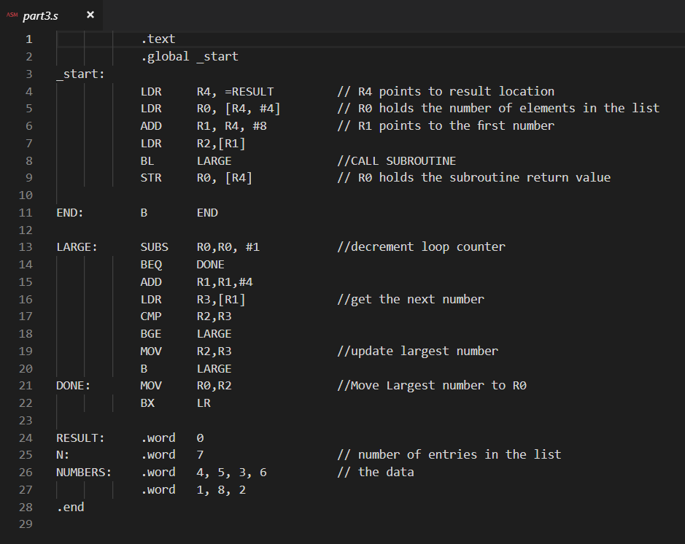

Slide 22
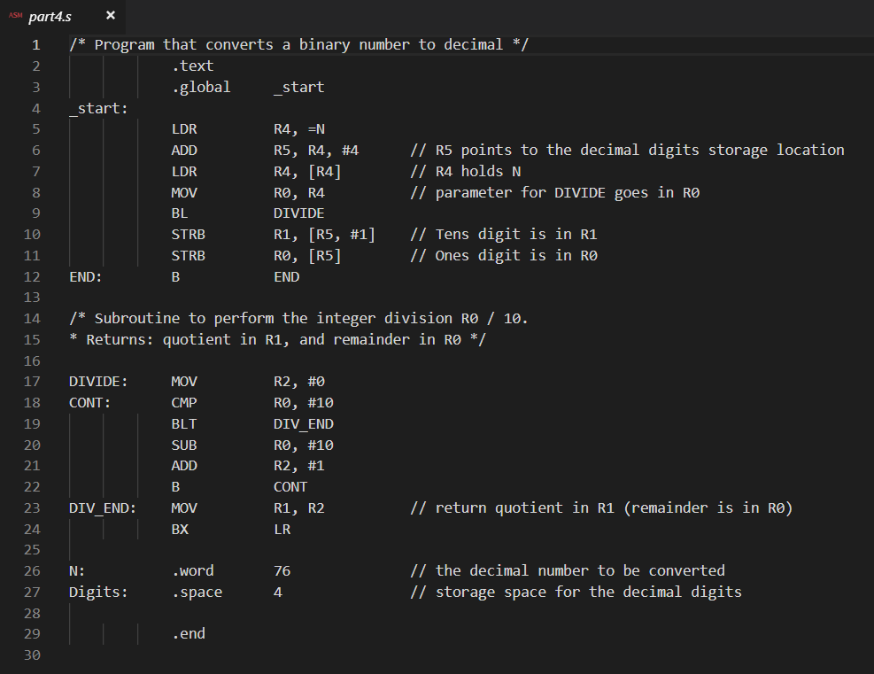
PART 4
Takes a binary number
and turns them into
decimal.
Example:
76 -> 00000706

Slide 23
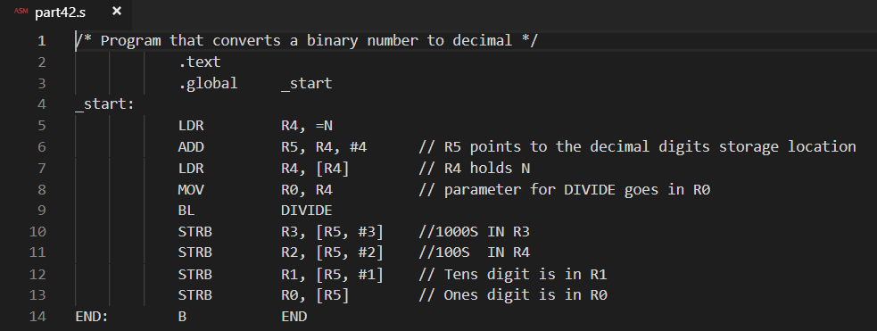
PART 4 – Modified for larger numbers

Slide 24
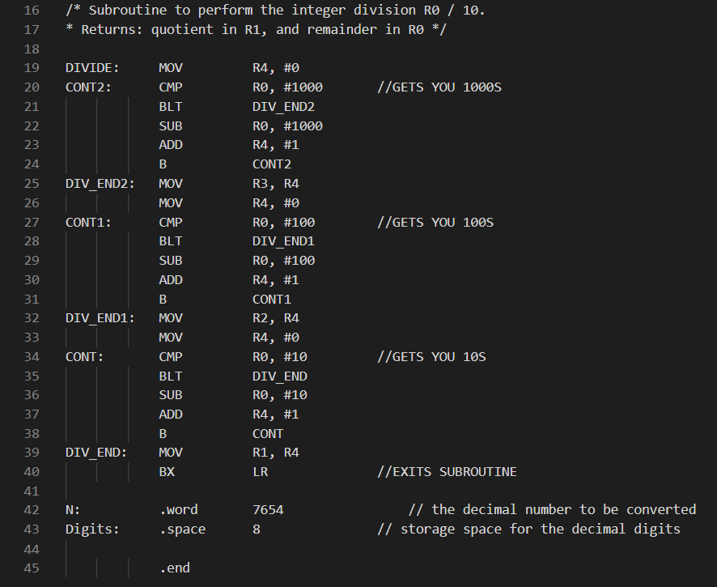
Subroutine for the modified code

